Slide 1

Review on Building a Secure Digital Signature System
DILEEP REDDY _ 2010030416
K. DIMPLE _ 2010030436
K. SIRISHA _ 2010030438
M. ROSHAN _ 2010030441
Under the Guidance of
Dr. S. Balaji
Professor
Computer Science and Engineering Department
KL Hyderabad Off Campus, Aziz Nagar ,Hyderabad

Slide 2

Overview
Introduction
Objectives of the project
Proposed Methodology/Architecture/Algorithm/Technique/etc
Implementation Details
Results
References

Slide 3
Introduction
Our Secure Digital Signature System project aims to provide the integrity and authenticity of digital documents, ensuring they remain unaltered and originating from verified sources in the digital systems.
Building a user-friendly graphical interface to simplifies the complex process of generating and verifying digital signatures, making it accessible even to non-technical users.
Using a Key management mechanism which safeguards keys from unauthorized access.
Implementing established standards such as RSA which are the foundation for generating secure digital signatures.

Slide 4
Objectives of the Project
Design and create an intuitive graphical user interface (GUI) that streamlines the generation and verification of digital signatures, accommodating users of diverse technical backgrounds.
Authentication and Integrity: Ensure the authenticity and integrity of electronic documents and messages by providing a reliable method for verifying the identity of the sender and detecting any unauthorized modifications.
Secure Communication: Enable secure communication by allowing users to digitally sign and verify documents, assuring that sensitive information remains confidential and unaltered during transmission.
Timestamping: Integrate timestamping capabilities to provide proof of the timing of signature creation, further enhancing the credibility and legal standing of digital signatures.
Security: Follow best practices in software development and cryptography to create a system that is resistant to common attacks, such as forgery, replay attacks, and unauthorized access.

Slide 5
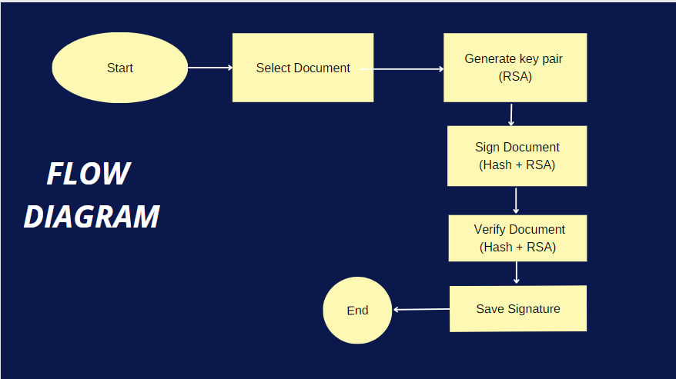
Proposed Methodology:

Slide 6
Implementation Details
Cryptographic Algorithm:
Plain text is converted into unreadable text which is known as cryptographic Algorithm.
RSA Algorithm which uses Asymmetric-key cryptography.
Both sender and receiver share a two keys to encrypt and decrypt the text.
Public to encrypt and Private to decrypt.
Hashing concept is used to secure data of the documents which is a unique code for the given key.

Slide 7
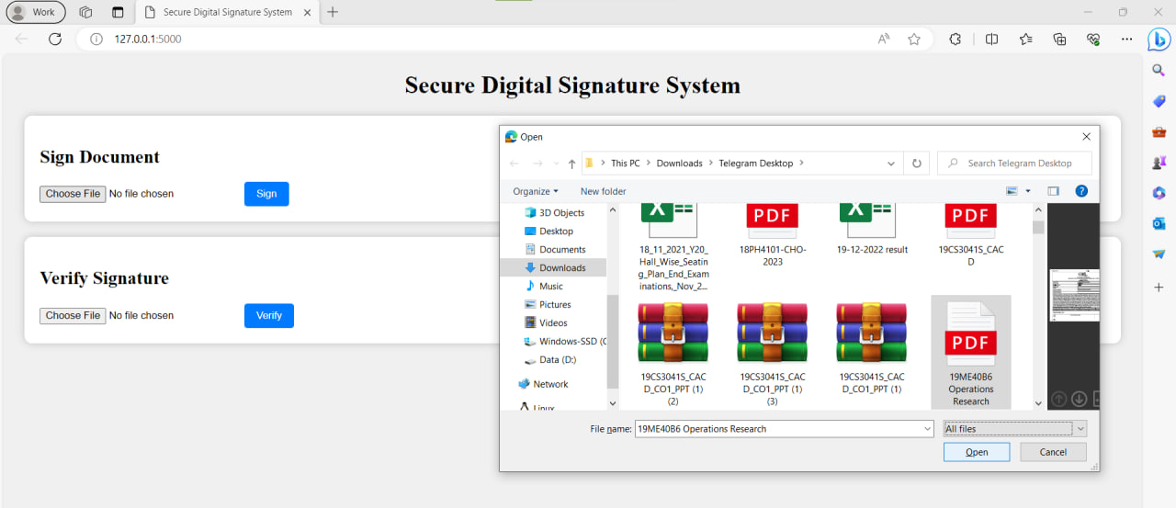
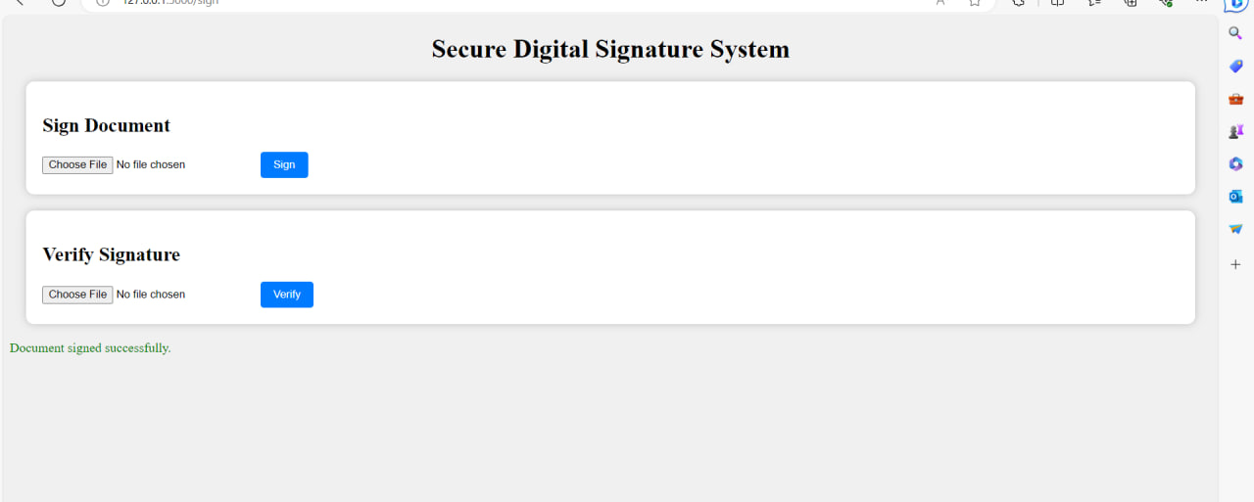
Results:
Signing a document:

Slide 8
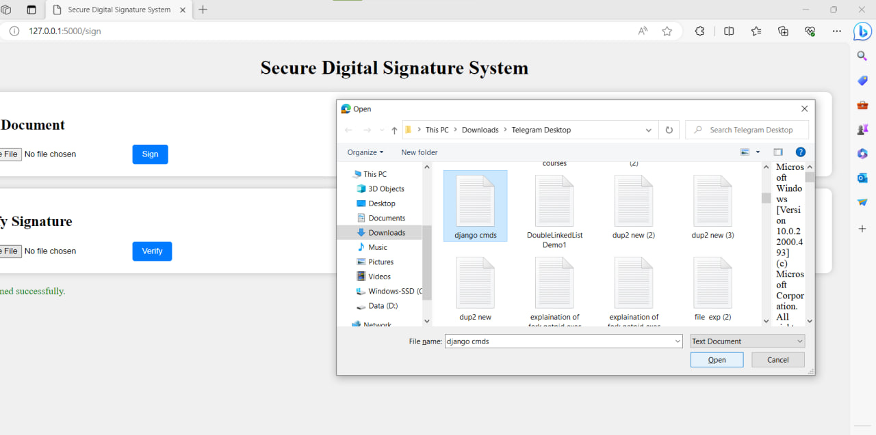
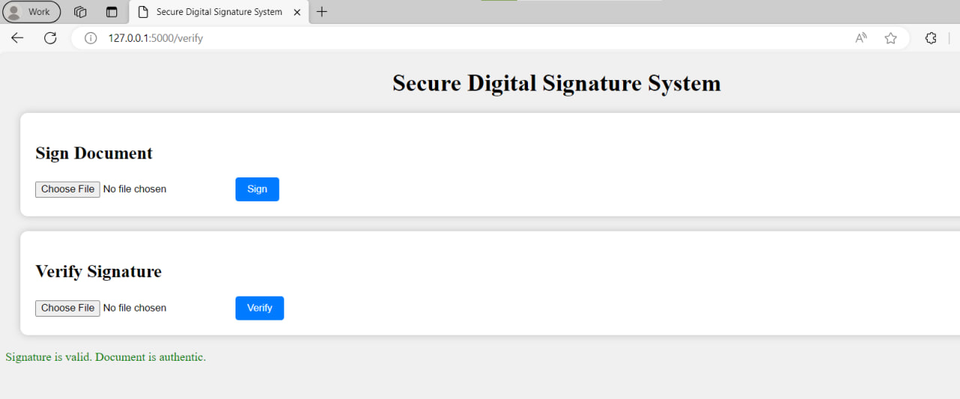
Results:
Verifying a document:

Slide 9
REFERENCES:
HTML 4.01 Specification, World Wide Web Consortium (W3C) specification, Dec. 1999; www.w3.org/ TR/html401.
2. Capicom Reference, Microsoft, 2012; http://msdn. microsoft.com/en-us/library/aa375732(VS.85). Aspx
S. Mazumdar, “XML Digital Signature Tool,” Mozilla Add-Ons, 2012; https://addons.mozilla.org/en-Us/ thunderbird/addon/xml-digital-signature-tool.
[I 1A.Herzberg. Personal Communication
[2]A. Rossanagel. “Digital Signature Regulation and European Trends.” http://www.emr-sb.de/news/Dsregulation.pdf
[3] CBrenn. Summary of the Australian Law on Electronic signatures. http://rechten.kub.n.lsimone/bretm.htm
[4]Digital Signature Trust. Certainsend Security: A Brief Technical Overview, http:l/www.trustdst.com/prod_scrv/ certainsendtech-overview. html
Introduction to Modern Cryptography Mihir Bellare, Phillip Rogaway.

Slide 10
THANK YOU

